Slide 1
Energy systems in Israel, Palestine and Jordan
Understanding the potential for regional cooperation
Aman Majid, Nurit Gal, Suleiman Halasah, Michael Gilmont, Jim Hall
Oxford Martin School, University of Oxford
June 2022

Slide 2
Background

Slide 3
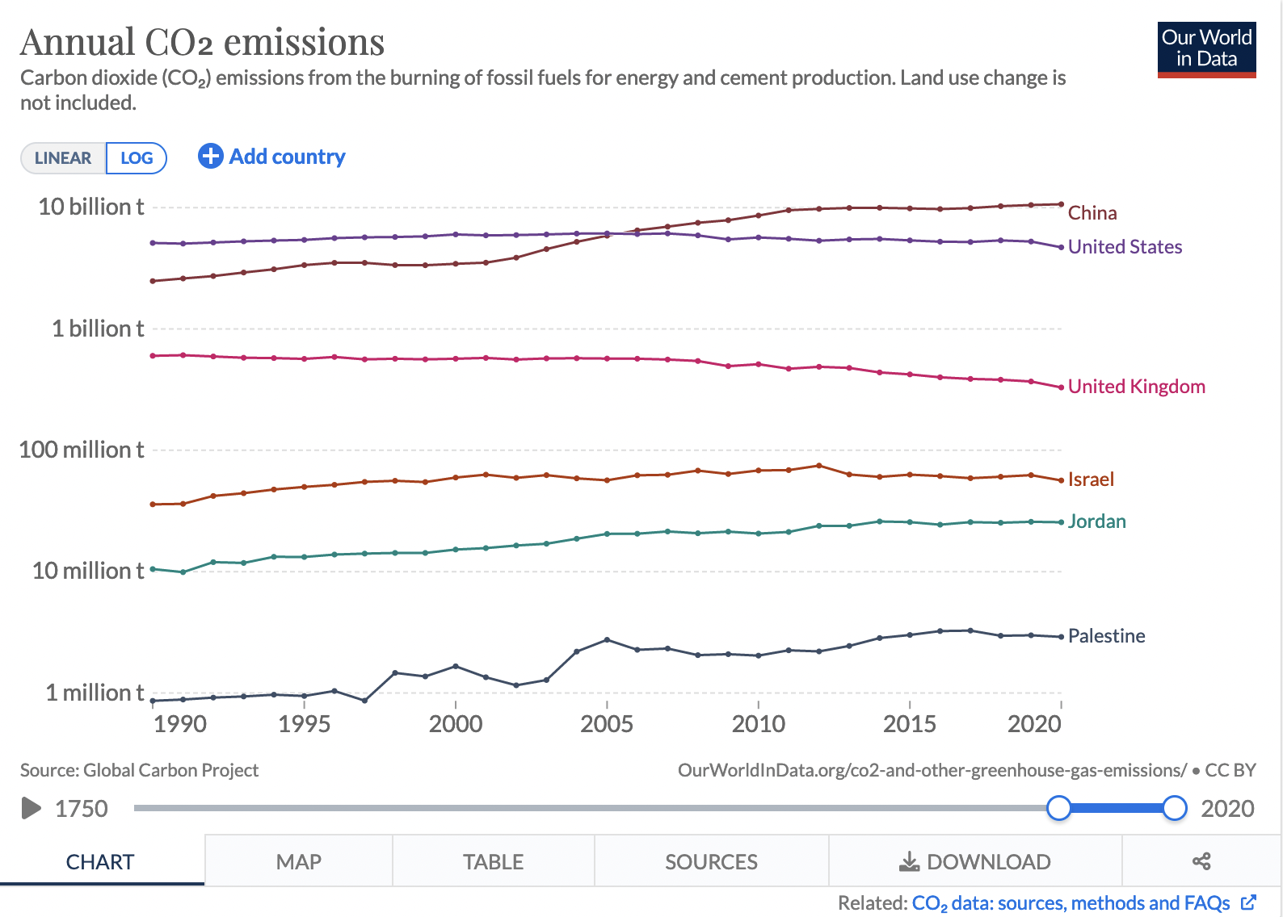
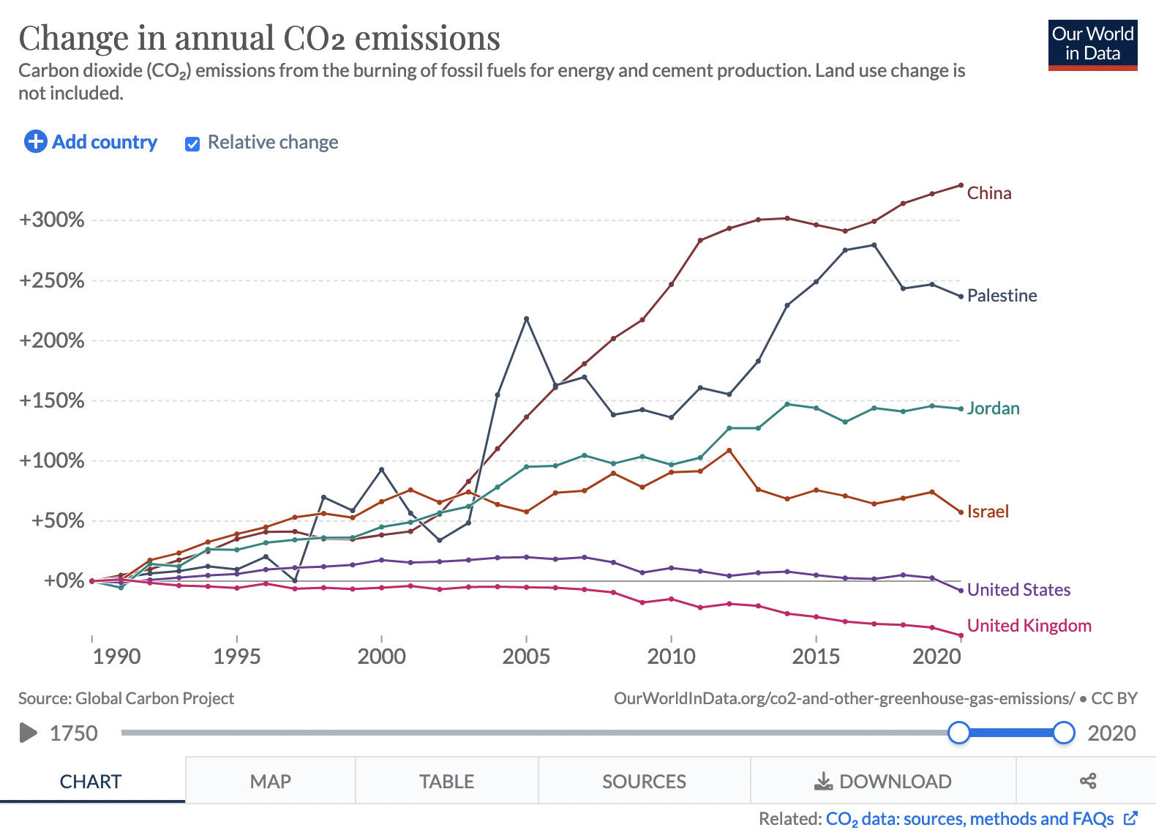
Background
Historical emissions

Slide 4
Background
Climate commitments
NDCs: GHG reductions | Israel | Jordan | Palestine
2030 | 27% | 31% | -
2040 | - | - | 26.6% or 17.5%
2050 | 100% | - | -
Israel to phase-out coal by 2026
Israel to increase renewable shares to 25% and 30% in 2025 and 2030
Palestine plans to convert Gaza diesel plant to gas
No specific renewables targets for Palestine
Renewable targets | Israel | Jordan | Palestine
Today | 8.5% | 20% | 5%
2030 | 30% | 50% | 20%

Slide 5
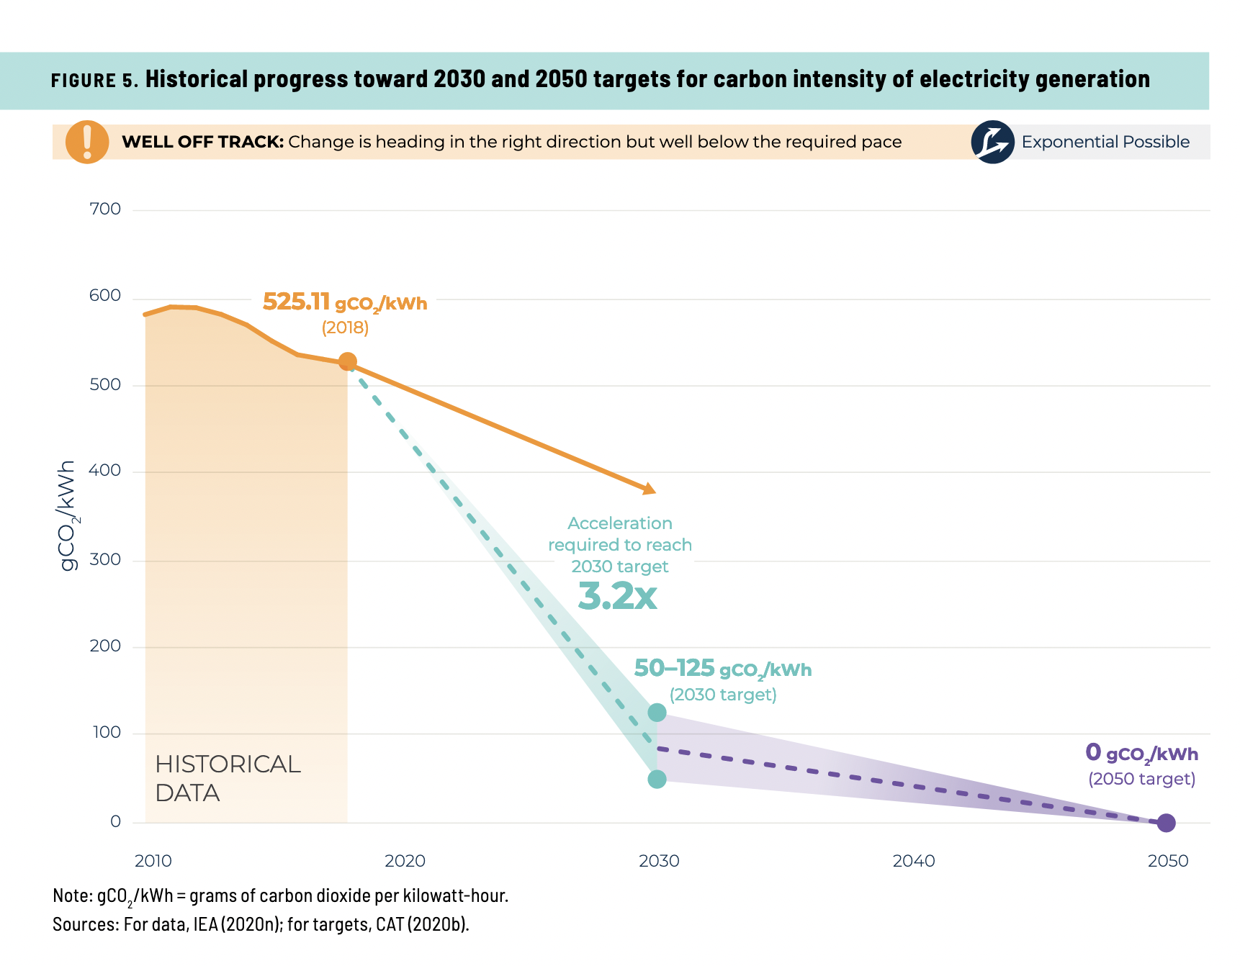
Speed and scale
Could level of ambition to decarbonise be increased?
The global power sector is not aligned with the Paris agreement
Numerous institutions (e.g., IPCC, IEA, CAT) calling for rapid and massive scale-up of renewables to 2030
Investing in fossil assets risks carbon lock-ins and stranded assets
Could cooperative energy policy could unlock deep decarbonisation in the region?
ISRAEL
JORDAN

Slide 6
The regional energy landscape

Slide 7
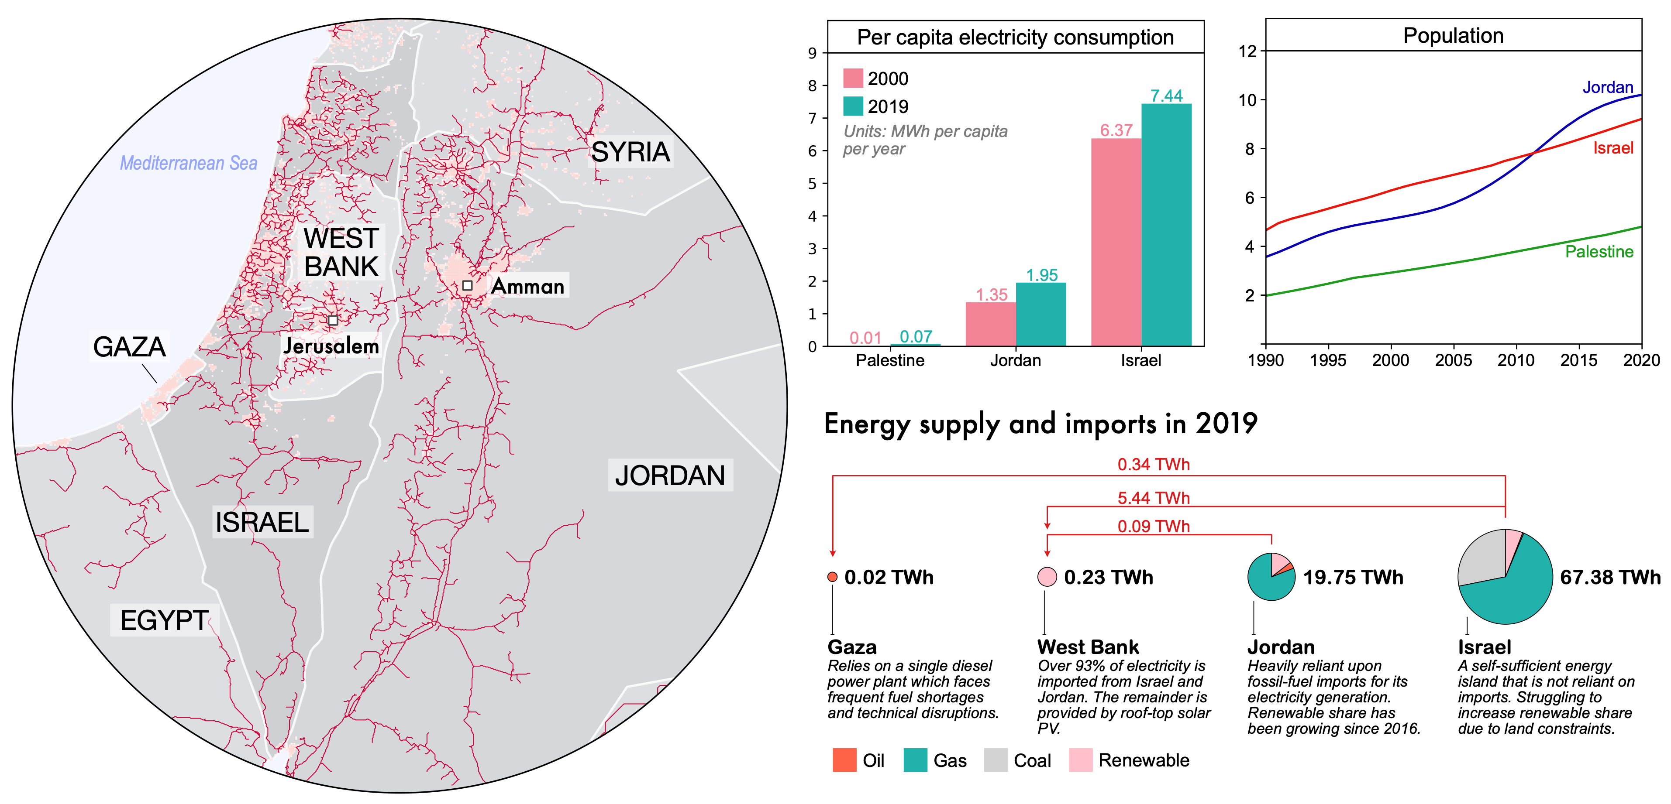
West Bank: 1.16 MWh/person
Gaza:

Slide 8
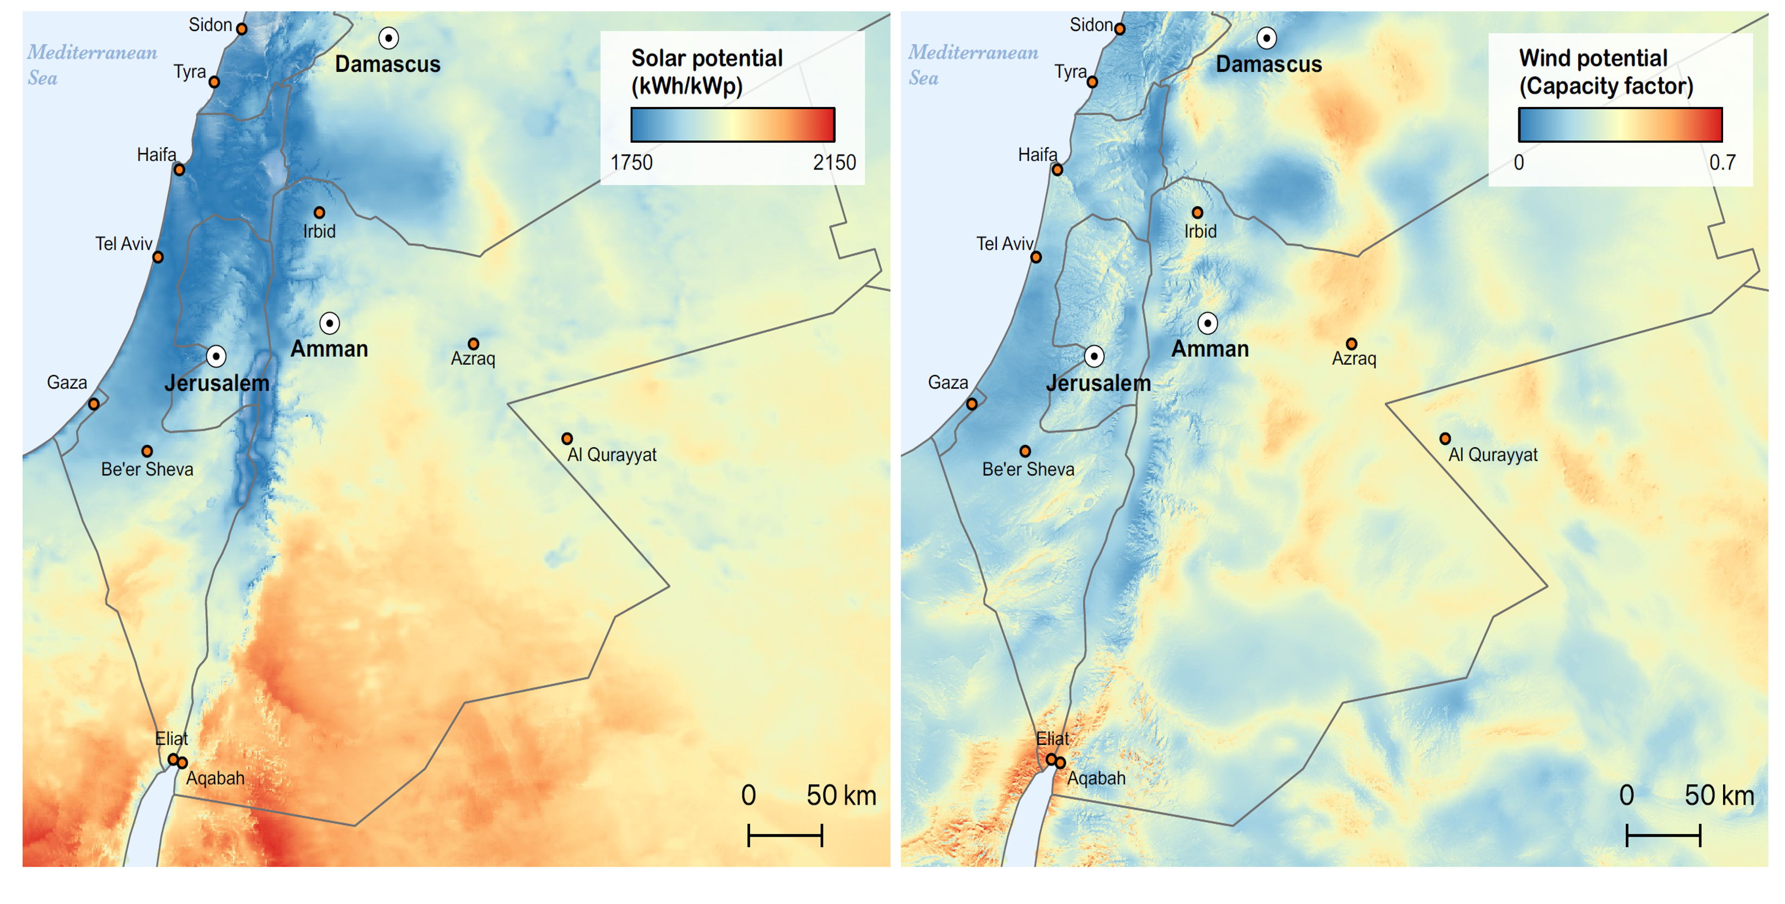
Solar and wind potential

Slide 9
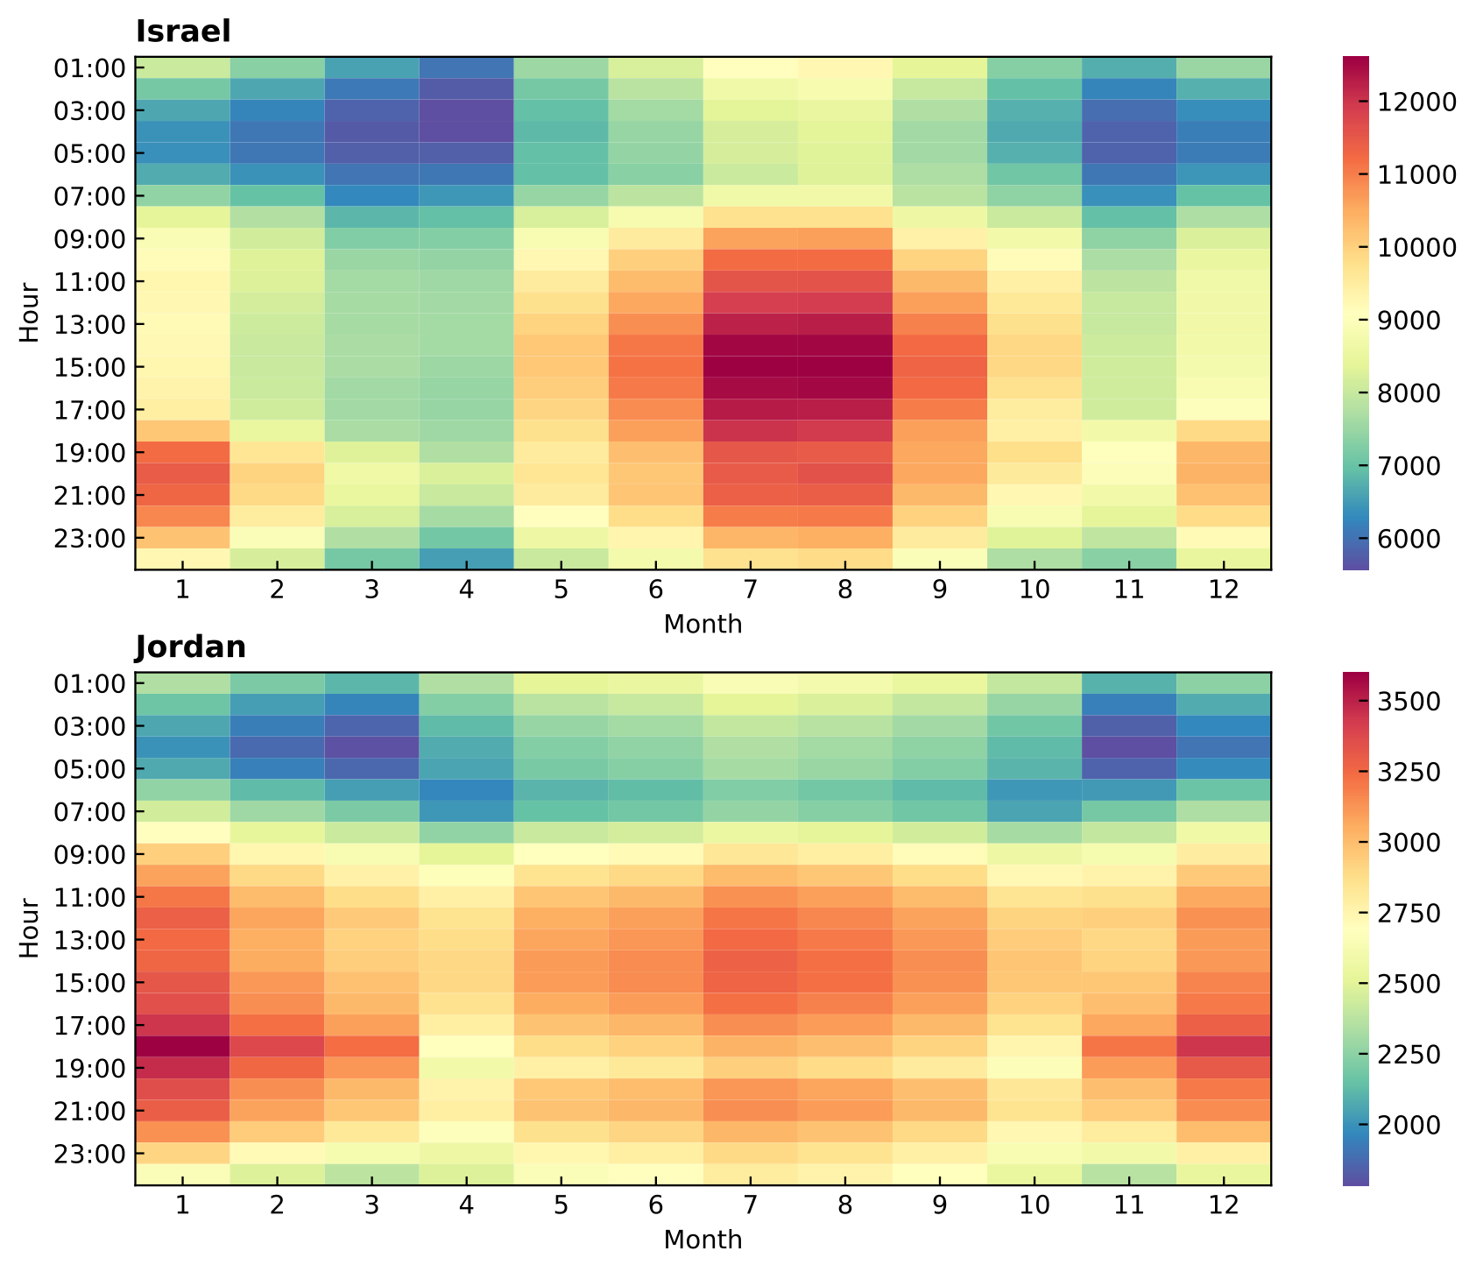
Trends
Costs of renewable energy technologies declining
Carbon reduction commitments (NDCs)
Varying potential of wind and solar across the region
Power demand patterns vary seasonally due to differences in cooling/heating demands and in energy-intensity
Increasing demand for desalination and air conditioning
Palestine still lacks reliable electricity supplies
Consideration of transboundary energy transfers (Prosperity Green project)
Energy demands

Slide 10
Issues
Israel:
Struggling to increase renewable capacity
Land allocation permits for renewable difficult to obtain
Jordan:
Demand does not match solar generation curves
Could have excess curtailment
Grid stability issues
Palestine:
Power supplies still unreliable
Gaza electricity access is poor
Wants to increase self-sufficiency

Slide 11
Our project

Slide 12
Plan energy systems to 2030 while considering:
Decarbonisation goals
Renewable goals
Regional cooperation

Slide 13
Methods

Slide 14





Model Inputs
Scenarios
Level of Cooperation
Applies only to Palestine
Growth projections
Hourly demand
Wind generation
Solar generation
Operational rules
Technical constraints
Self-sufficiency targets
Emissions
targets
Renewable targets
Model
CAPACITY EXPANSION MODEL
SIMULATION MODEL
Optimisation algorithm chooses a mix of technologies that meets targets at lowest cost
Computer model simulates how system would perform under new technology mix
Results
Capacities
Dispatch curves
Renewable curtailment
Costs
Technology mix
Emissions

Slide 15
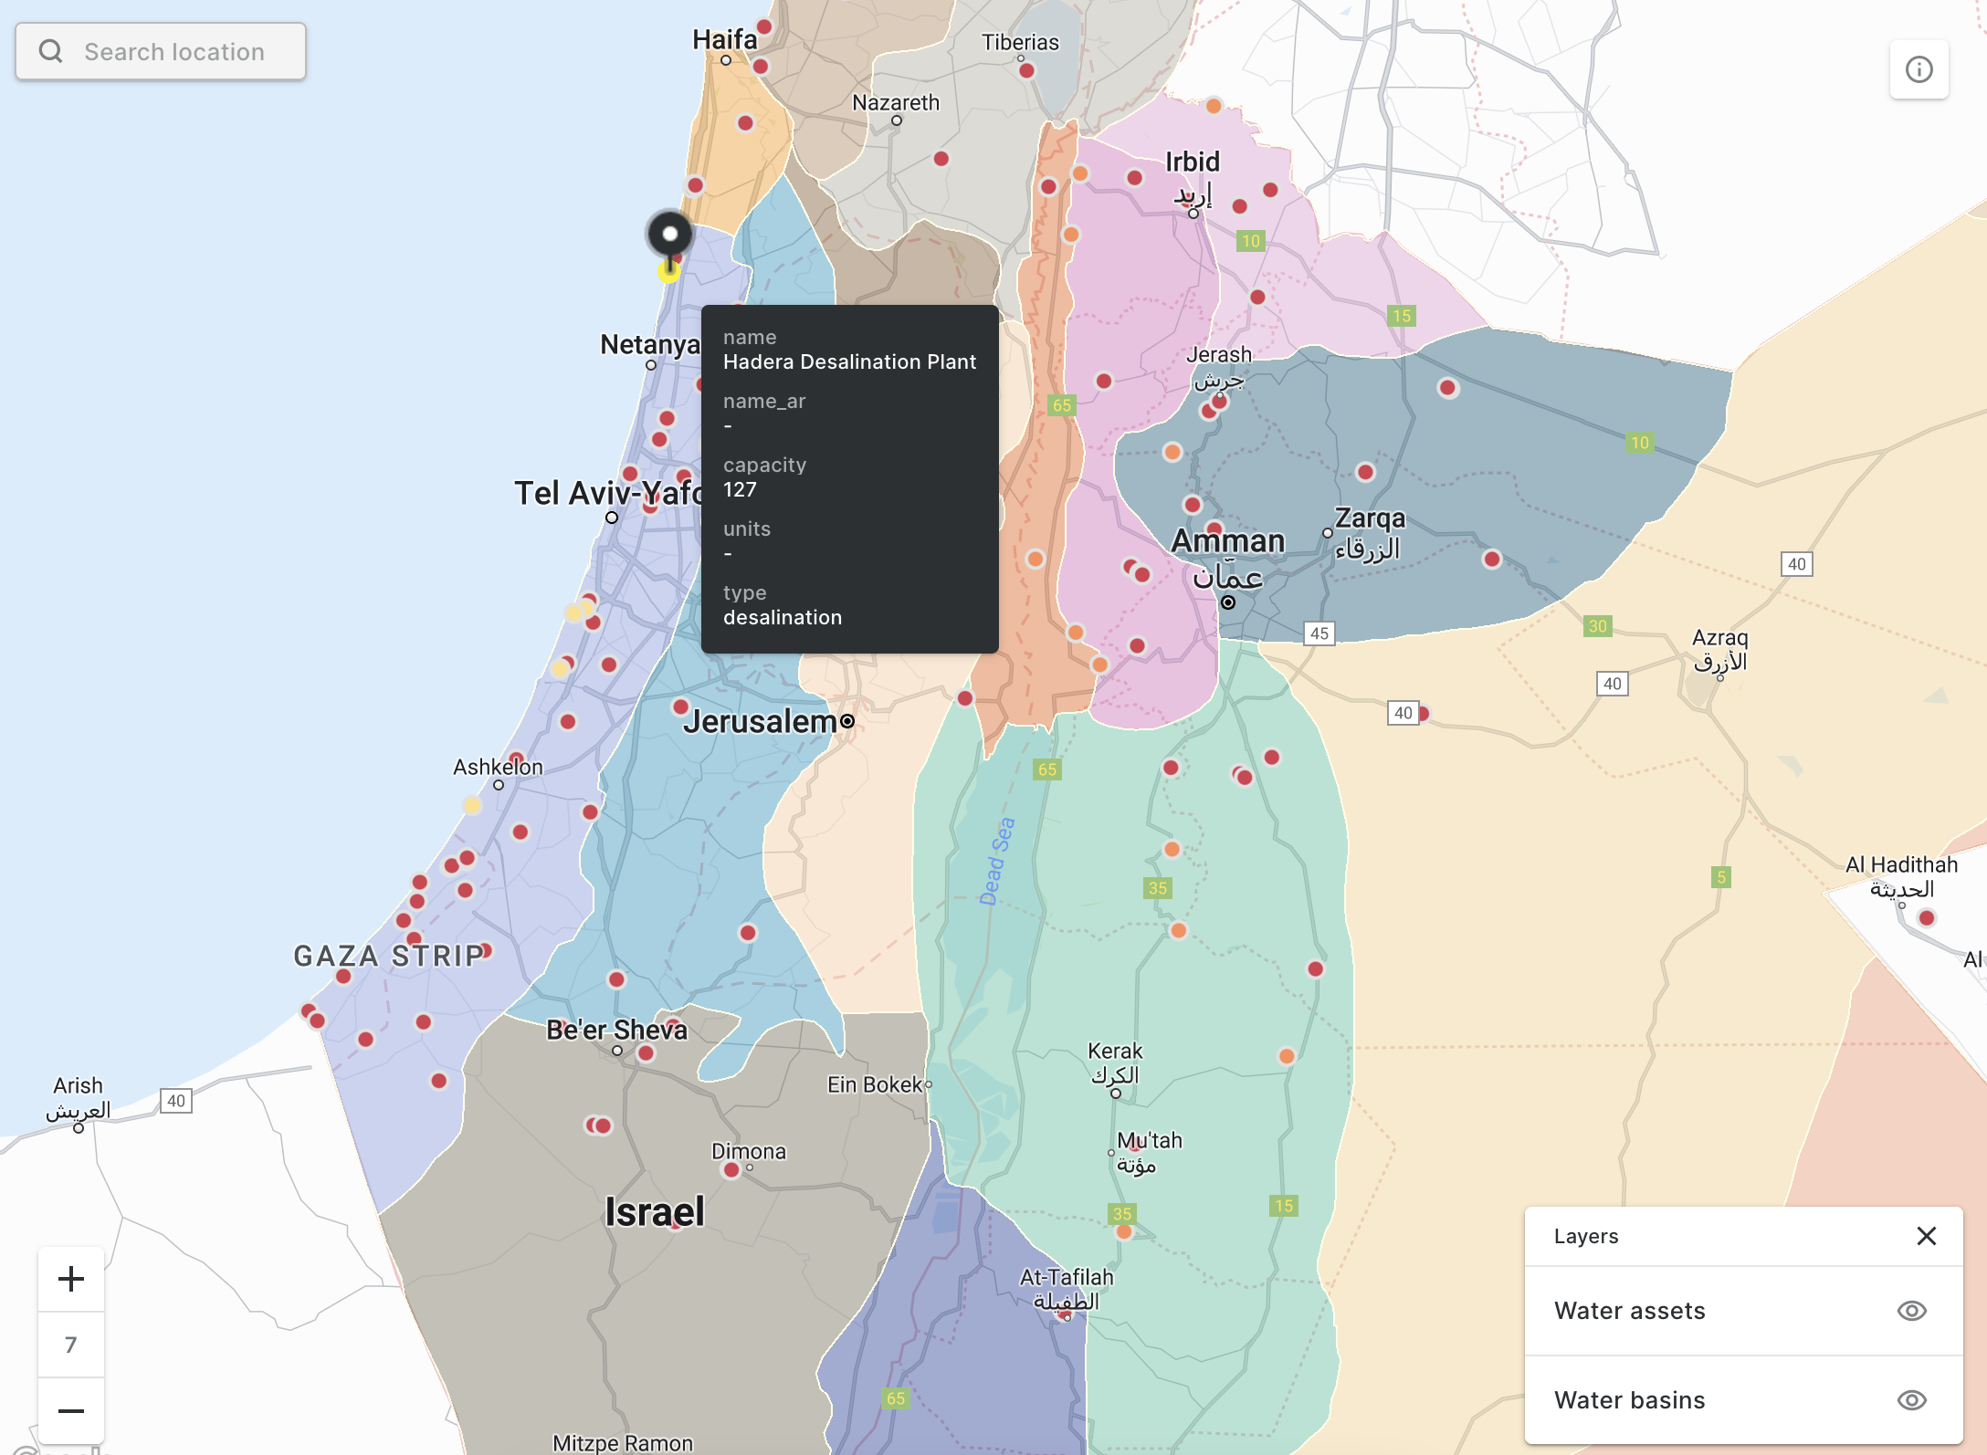
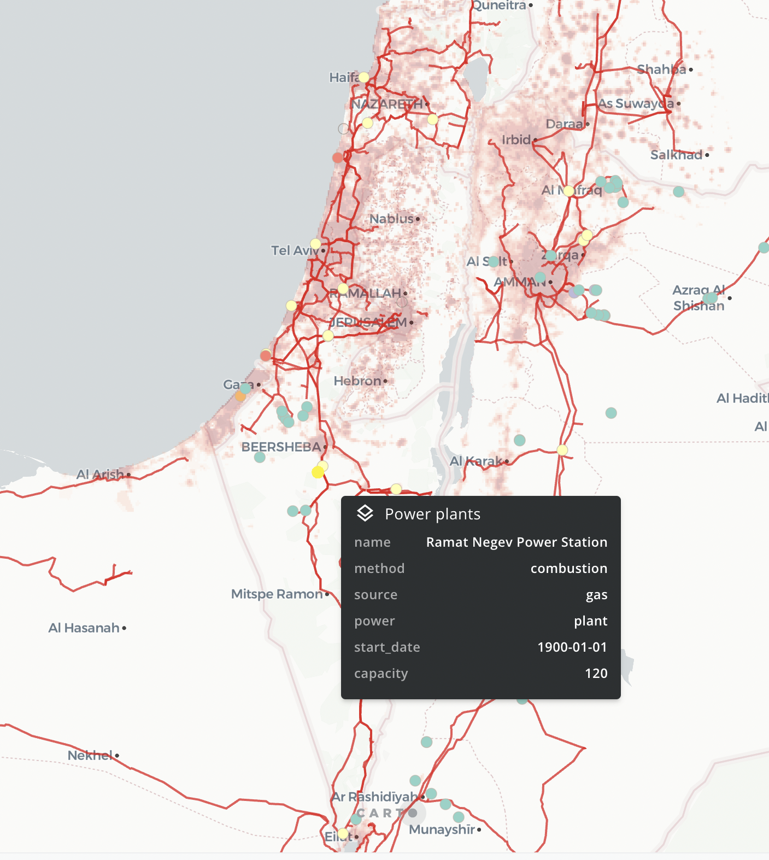
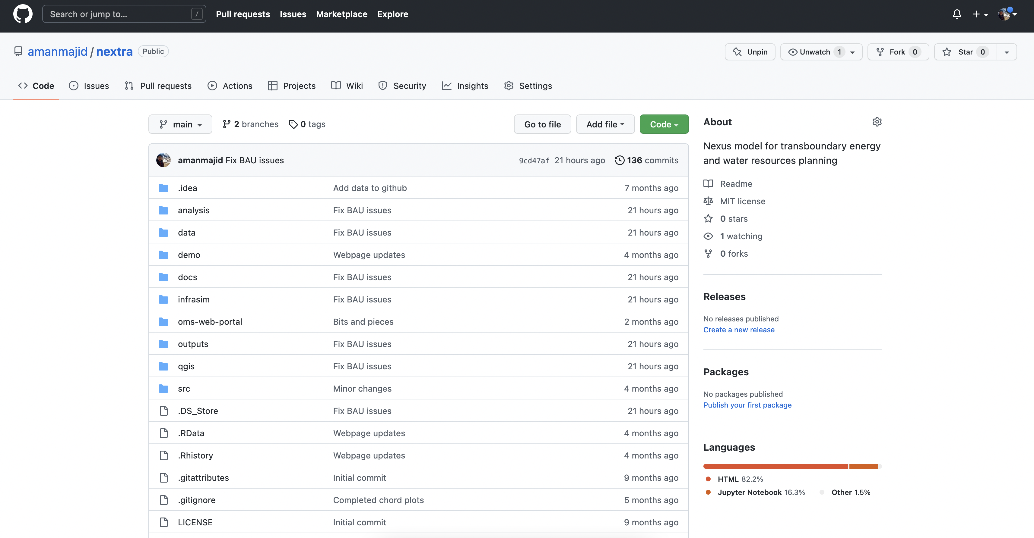
https://github.com/amanmajid/nextra

Slide 16
Scenarios
Increasing
decarbonisation ambition
NCO
BAU
COO
All scenarios meet:
Future demands
Renewable targets
Palestinian self-sufficiency
BAS
Increasing cooperation

Slide 17
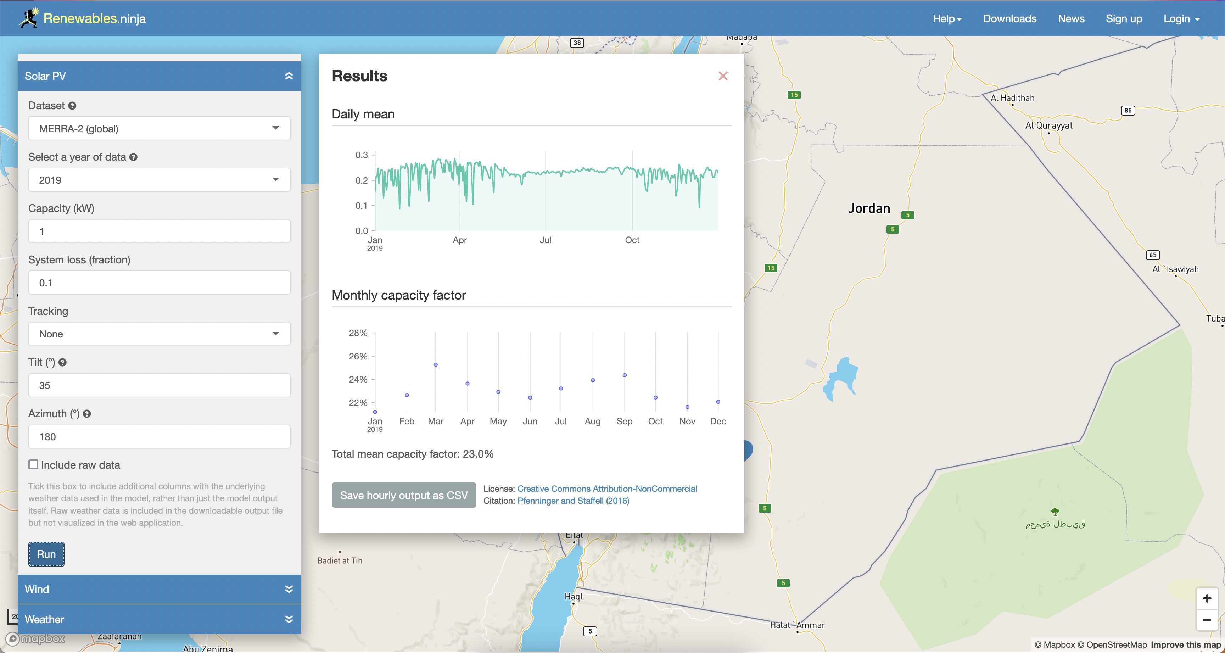
Limitations
Estimated data for Jordan and Palestine
Electricity demand curves
Generation curves
True RES capacity factors
Transmission constraints
System features (e.g., efficiencies and losses; operational rules etc.)
Modelled outputs presented here will be different from bottom-up estimates within countries

Slide 18
Preliminary Results

Slide 19
Costs
BASELINE
BUSINESS-AS-USUAL
9.4%
Reduction in costs relative to current plan (BAU)
COOPERATION
NON-COOPERATION
x2.4
Investment in Jordan increases relative to current plan (BAU)

Slide 20
Capacities
24%
Reduction in build-out of solar and battery storage compared to current plan (BAU)
x2.2
Total capacity needed in Jordan compared to current plan

Slide 21
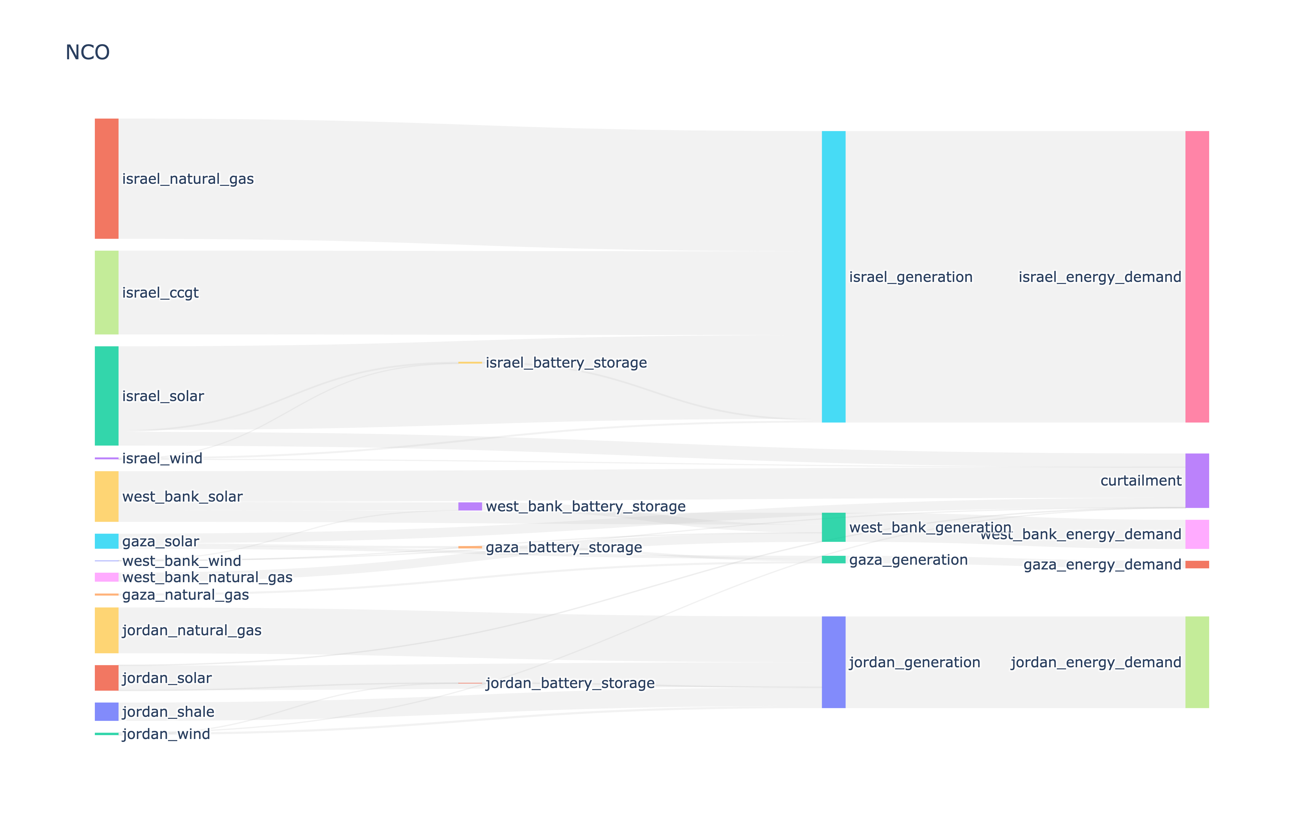
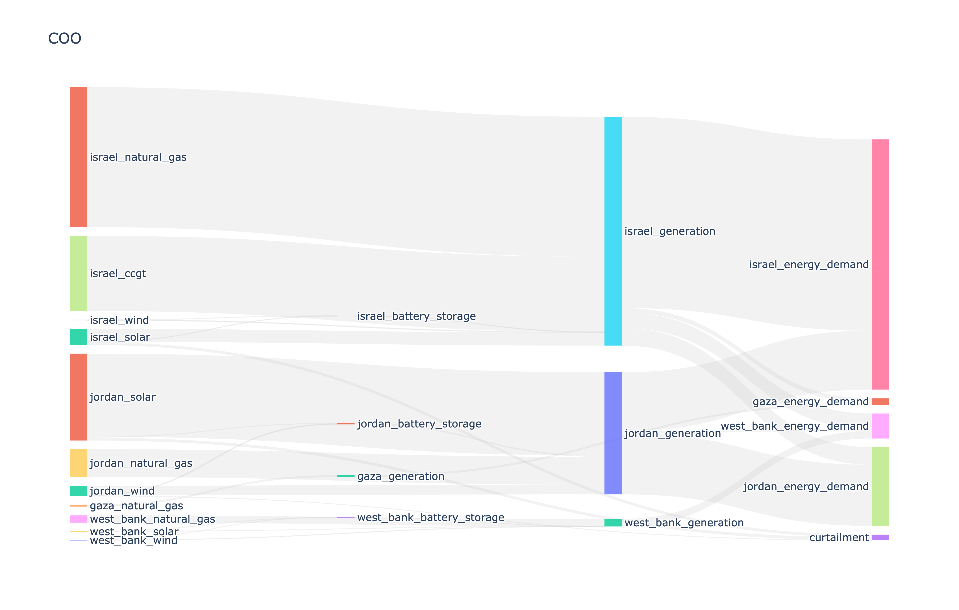


Electricity flows
x20
NCO
More renewable curtailment in non-cooperative (NCO) operations compared with cooperative (COO) case
COO

Slide 22
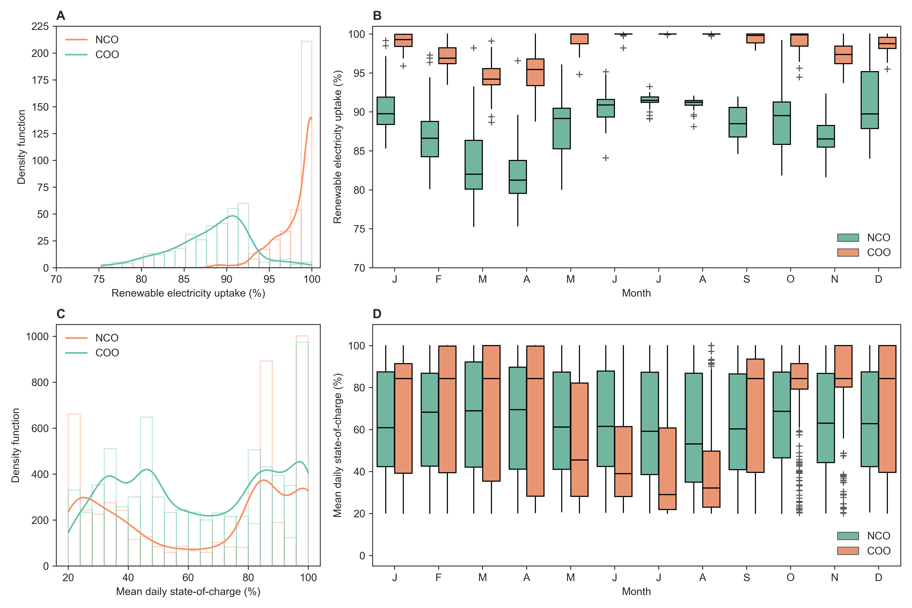
Renewable uptake
Utilisation under non-cooperative and cooperative operations
>90%
Jun-Aug
Daily renewable utilisation under COO
Generally exhibit greatest levels of renewable uptake. Excess supplies during Feb-Apr.

Slide 23
Self-sufficiency
Capacity changes due to Palestine’s self-sufficiency targets
8%
Reduction in Israel’s total capacity requirements between 10-100%
x12
Total capacity increase in Palestine between 10-100% self-sufficiency
Based on current operational configurations (BAU)
Notes:
Can we disaggregate this by technology (e.g. Fossil and Renewable)?

Slide 24
Deep decarbonisation
How could cooperation deliver net-zero?
XX%
Total capacities of solar, wind and storage
Reduction in costs relative to current plan (BAU)
Values aggregated for Israel, Jordan and Palestine
22%
Less capacity of renewables and storage needed under cooperative (COO) system
$47 billion
Total saving to achieve net zero by 2030 under cooperative (COO) energy policy

Slide 25
Conclusions

Slide 26
Results
Summarising our findings
Cooperative (COO) energy planning and management has significant benefits:
Reduce costs by 28% compared to current plan (BAU)
Improves renewable energy uptake and reduces curtailment
Pursuit of self-sufficiency (NCO) is challenging:
Much higher renewable build-out with greater curtailments
Costs almost twice as much as the cooperative case (COO)
Very large costs for Palestine
Scale and ambition could be increased:
To align regional power sector with Paris agreement
Working to net zero cooperatively (COO) is much more economical

Slide 27
Supporting slides

Slide 28
Scenarios
Baseline (BAS):
No consideration of sustainable development goals;
Continue with business-as-usual practices;
Quantifies minimum infrastructure needed without sustainable transitions
Business-as-usual (BAU):
Continue with current practices;
Develop sustainably: observing renewable/carbon targets;
Palestine aims for minimum level of self-sufficiency (30%)
Non-cooperation (NCO):
Develop sustainably: observing renewable/carbon targets;
Zero cooperation between regions;
Each region acts as an energy island
Cooperation (COO):
Develop sustainably: observing renewable/carbon targets;
Complete cooperation between regions (i.e., unlimited energy trading);
Palestine aims for minimum level of self-sufficiency (30%)
Increasing
decarbonisation ambition
NCO
BAU
COO
BAS
Increasing cooperation

Slide 29
Capacities

Slide 30
Next steps
Sense-check our scenarios and results
Scope feasible options for cooperative energy management
Further opportunities to explore: e.g., the role of green hydrogen

Slide 31
Battery usage
State-of-charge (SOC) under NCO and COO
Need to further analyse:
The daily SOC under COO is generally lower; particularly around summer months. This helps RES uptake to increase — why does this not happen under NCO?

Slide 32
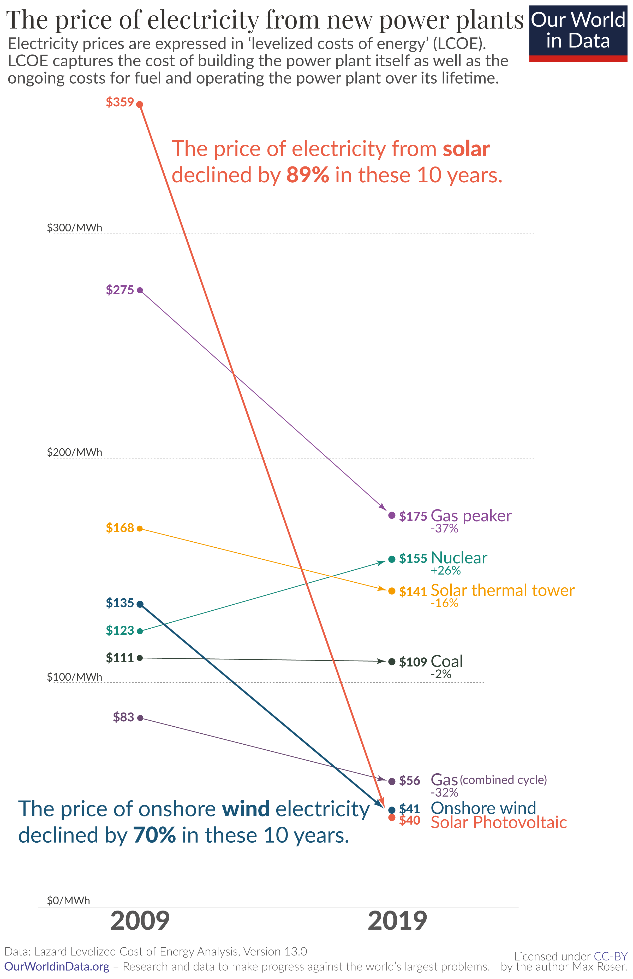
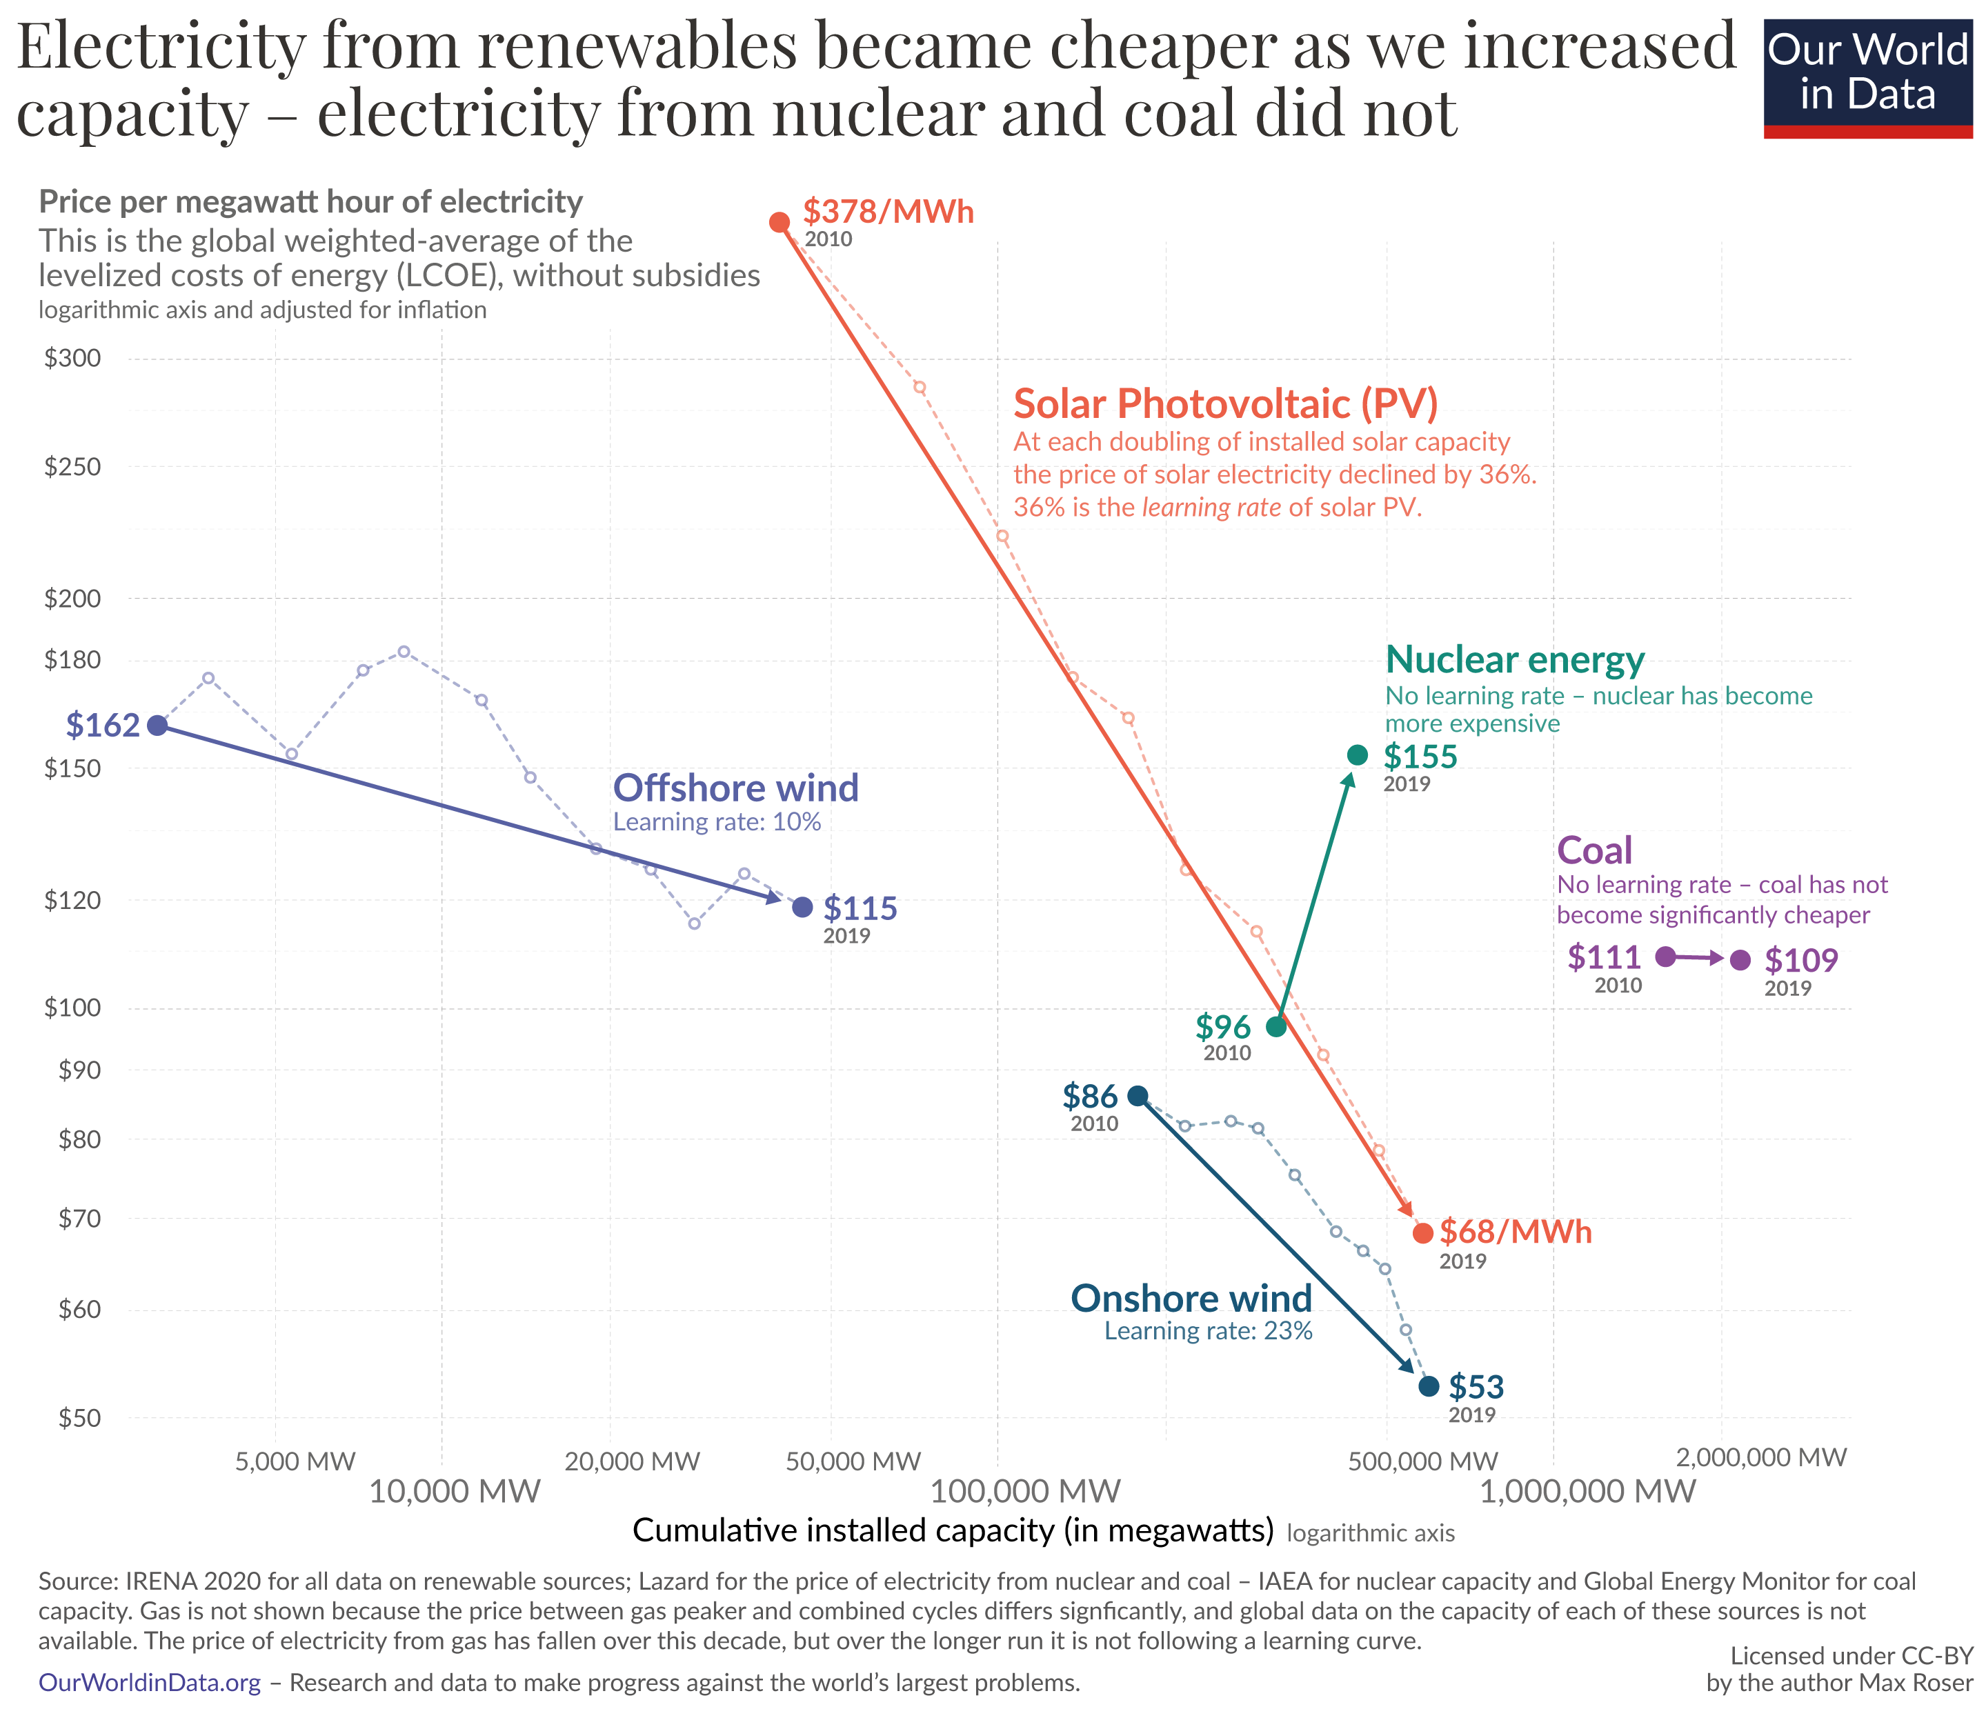
Renewable cost curves

